Slide 1
Phase I Funding Proposal IEEE Student Branch at The University of Texas at Austin
IEEE Central Texas Section
Fall Planning Meeting 2014
San Marcos, Texas
Adviser: Sriram Vishwanath, sriram@ece.utexas.edu

Slide 2
Branch Overview
Over 500 total members
Developing a closer relationship with community, college, department, section, and corporate supporters
Working closely with student Society chapters: ComSoc, CS, Power & Energy, RAS, HKN, and WECE
Increasing active membership, member retention, participation in CTS activities, and post graduate retention in IEEE.

Slide 3
Branch Executive Officers
Josh Frazor, Chair
Tyler Walker, Vice Chair
Kyle Cousino, Executive Director
Walter Oji, Corporate Director
Haley Alexander, Treasurer
Ross McNulty, Secretary
All officers serve terms of one school year.

Slide 4
Budget and Costs
Major source of funds: corporate support
Other sources include student organization grants and the Central Texas Section
Some costs recouped through participation fees and other charges (ex: Food Sales)
Expected expenditures ~$18,000 for all activities during 2014-2015 school year, with a stronger focus on social outreach, professional development, and student mentorship

Slide 5
Previous CTS Contributions
Last year’s CTS Phase I funding ($1000):
IEEE Welcome Week ($400): The 5th annual Welcome Week consisted of activities that targeted incoming freshmen and transfer students, with the goal of introducing them to the ECE Department and the IEEE Student Branch.
Leadership Retreats ($300): A way for students to participate in IEEE and other leadership roles, and receive some training on the responsibilities of UT student branch officers
IEEE Region V Conference ($300): Allow students to view IEEE in action post graduation and participate in competitions against fellow IEEE Branches.

Slide 6
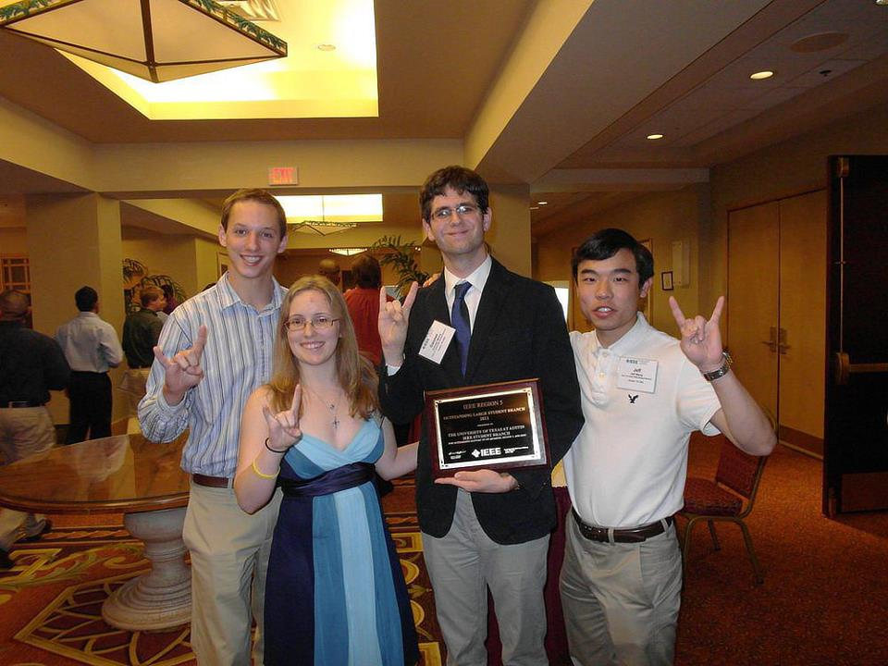
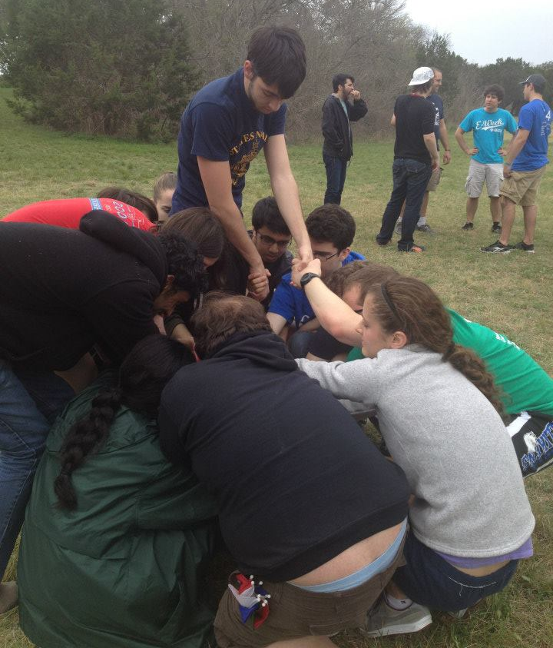
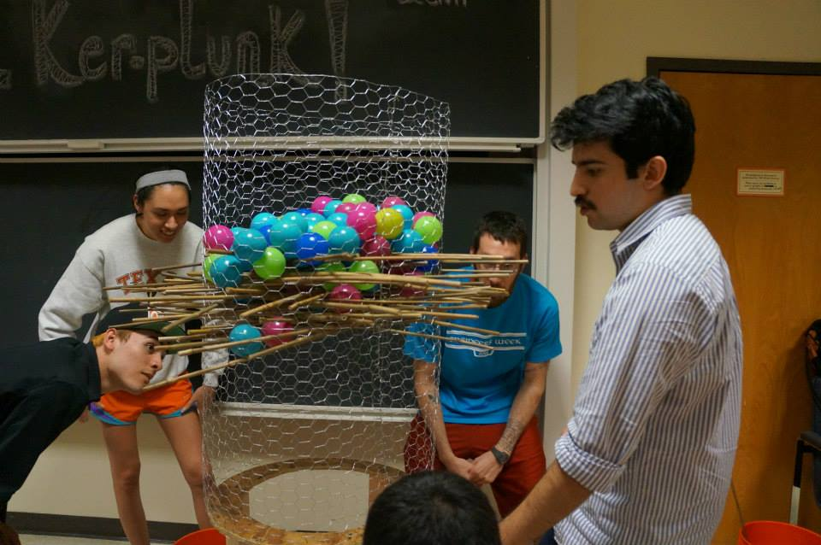
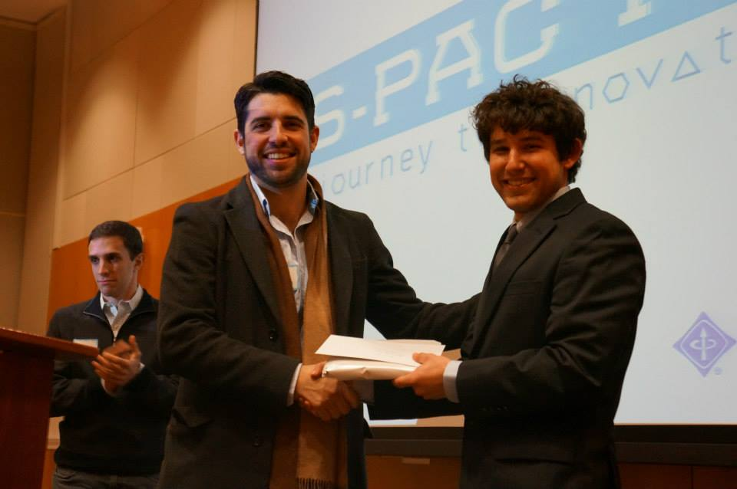

Slide 7
CTS Commitment
Request for 2013 is $1,000, to be divided as follows:
IEEE Welcome Week ($400): Continuing our successful events from last year to boost our membership and retain membership
Leadership Retreats ($300): Expanding the leadership retreats to accommodate more students interested in becoming active in IEEE and the ECE community
Region V ($300): Attend Region V Competition in force for next year to increase presence in CTS, give upperclassmen a better understanding of IEEE post graduation, and interact with other Student Branches.

Slide 8
Conclusion
Great prospects for this school year
CTS funding is crucial for several branch programs
Officers are reachable for further questions:
Josh Frazor, chair@ieee.ece.utexas.edu
Tyler Walker, vicechair@ieee.ece.utexas.edu
Walter Oji, corporate.director@ieee.ece.utexas.edu

